Slide 1

Week 2 - GM2
Cab Investment Firm
11/24/2023

Slide 2
BACKGROUND
XYZ is a private equity firm in US. Due to remarkable growth in the Cab Industry in last few years and multiple key players in the market, it is planning for an investment in Cab industry.
Objective: Provide actionable insights to help XYZ firm in identifying the right company for making investment.

Slide 3
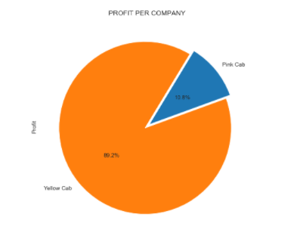
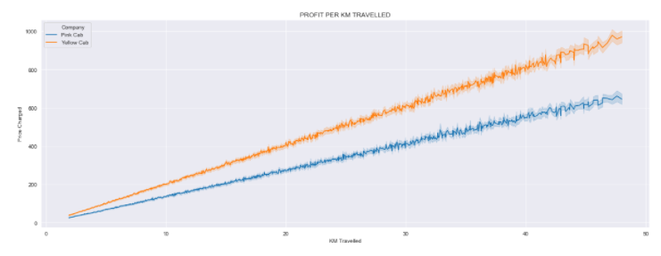


Slide 4
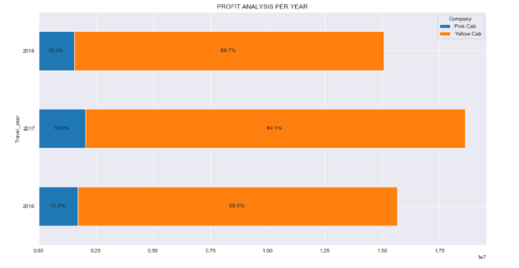
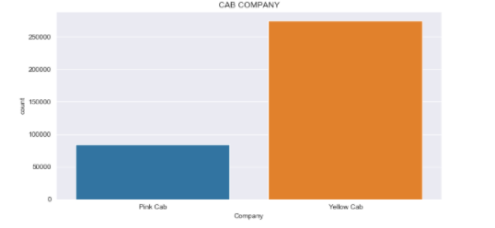
Majority is cab users travelled with Yellow Cab company. Yellow cab makes about 90% of the total profit each year.

Slide 5
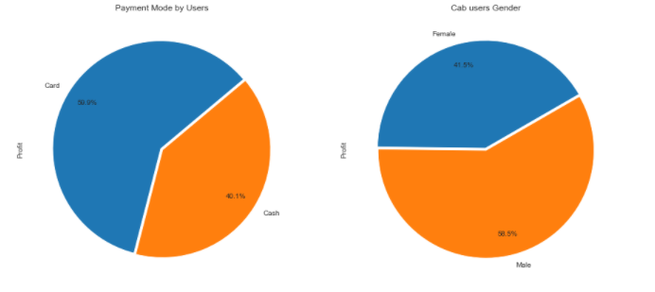
Most cab users are male, and prefer paying with Card.

Slide 6
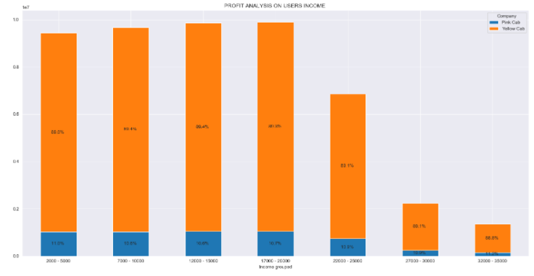
Yellow cab has higher users income

Slide 7
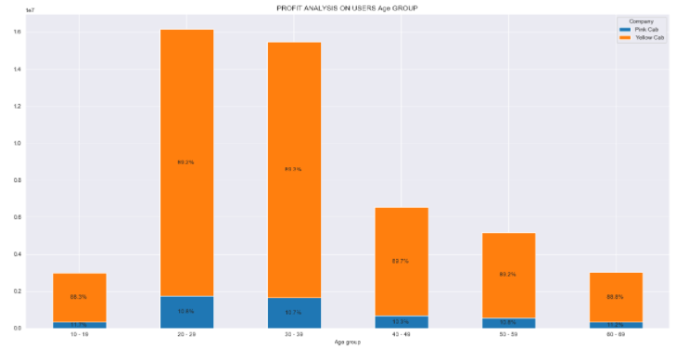
Most cab users age from 20 to 39 years old

Slide 8
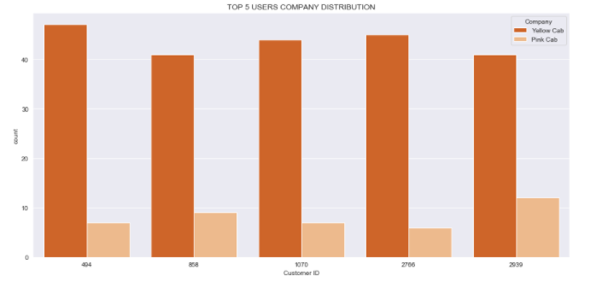
The top 5 cab users mostly travelled with Yellow cab

Slide 9
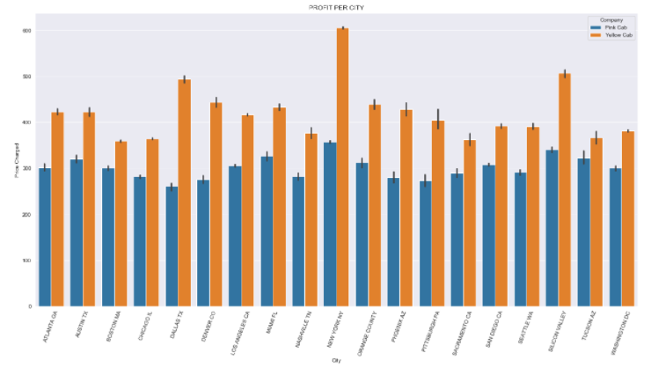
Yellow Cab company charges higher than the Pink Cab company in all cities

Slide 10
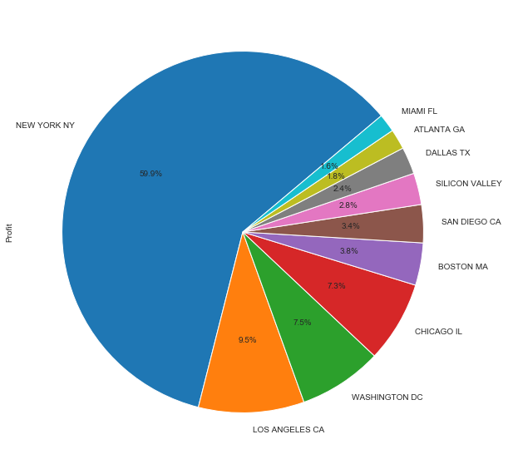
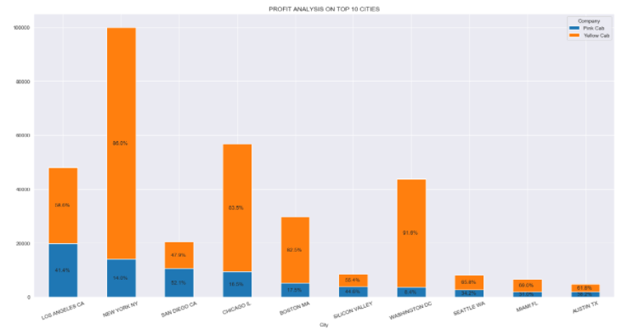
The comapanies made profit from the most populated city in terms of cab users but Yellow cab company made more profit in the top 10 cities with the most users. New York city has the highest number of users.

Slide 11
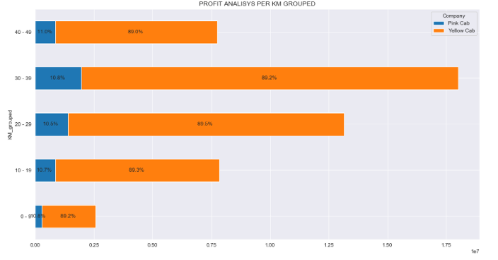
The number of Km travelled registed from yellow cab and Pink cab company.

Slide 12
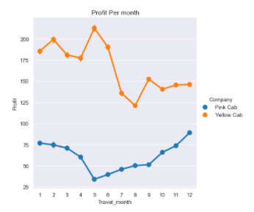
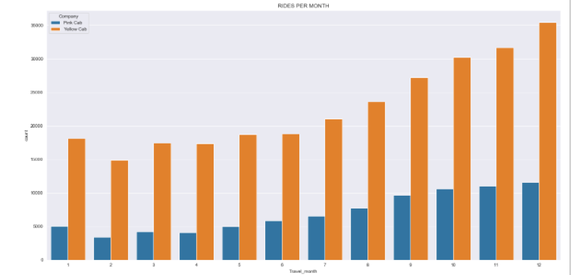

Slide 13
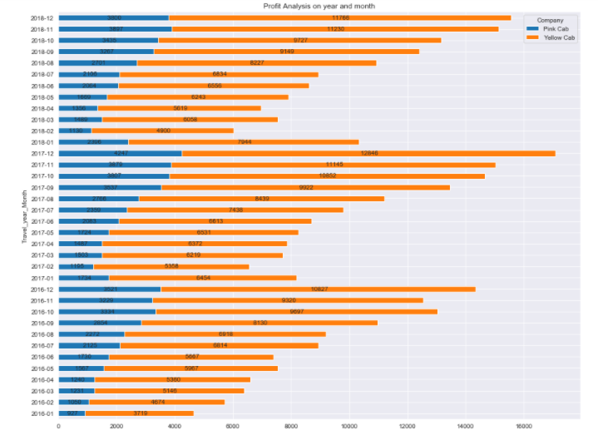
Most of the customers travelled with Yellow cab company
Yellow cab has more users

Slide 14
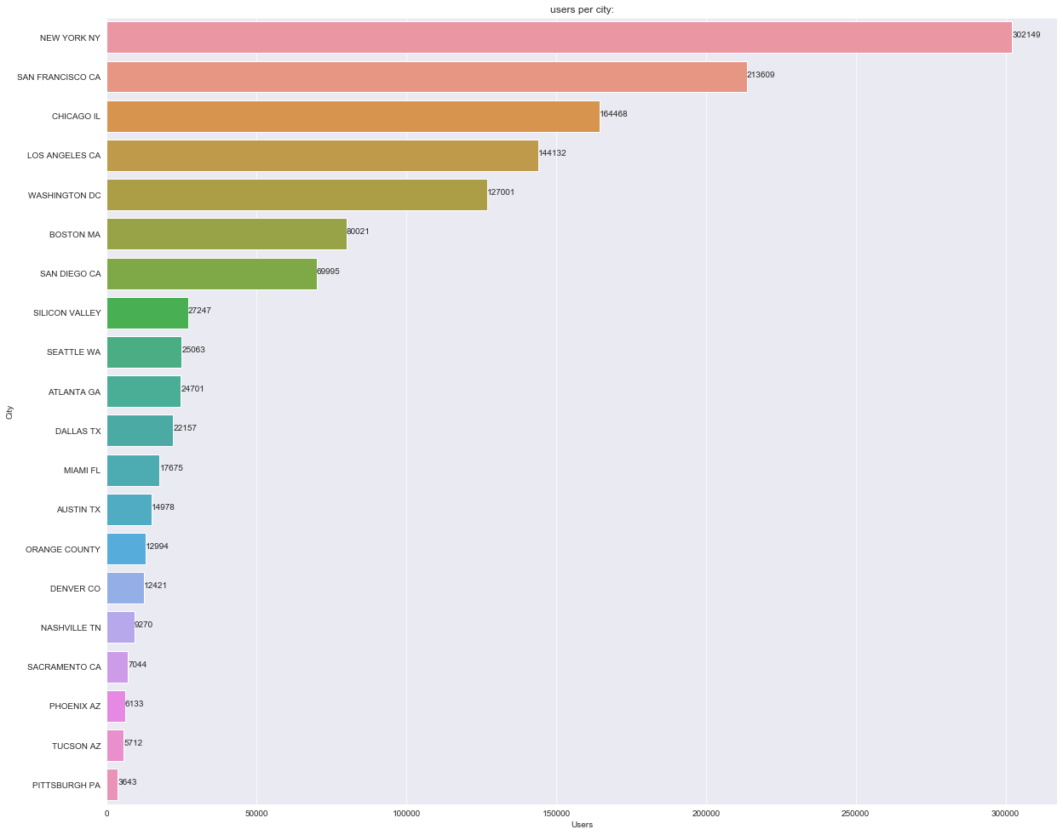
New York has the highest number of cab users then San Francisco, chicago etc.

Slide 15
RECOMMENDATIONS
Yellow cab has higher customer reach.
Yellow cab Company has more users in major cities.
The top users had more than 40 rides with Yellow cab and 10 rides with Pink Cab.
Cab users prefer Yellow cab.
Yellow cab has customer in all age group.
It’s popular in 60+ age group.
Both cabs are similar in high and medium income class.
Most cab users travelled mostly in December and November.
Yellow cab has 3times the number of Pink cab customers.

